Slide 1
DATA607 - COVID Data
Josh Iden and Jawaid Hakim

Slide 2
Motivation
Use COVID-19 datasets to explore global pandemic stats
Explore relationships between COVID-19 prevalence and other datasets, e.g. mask policies, S&P500

Slide 3
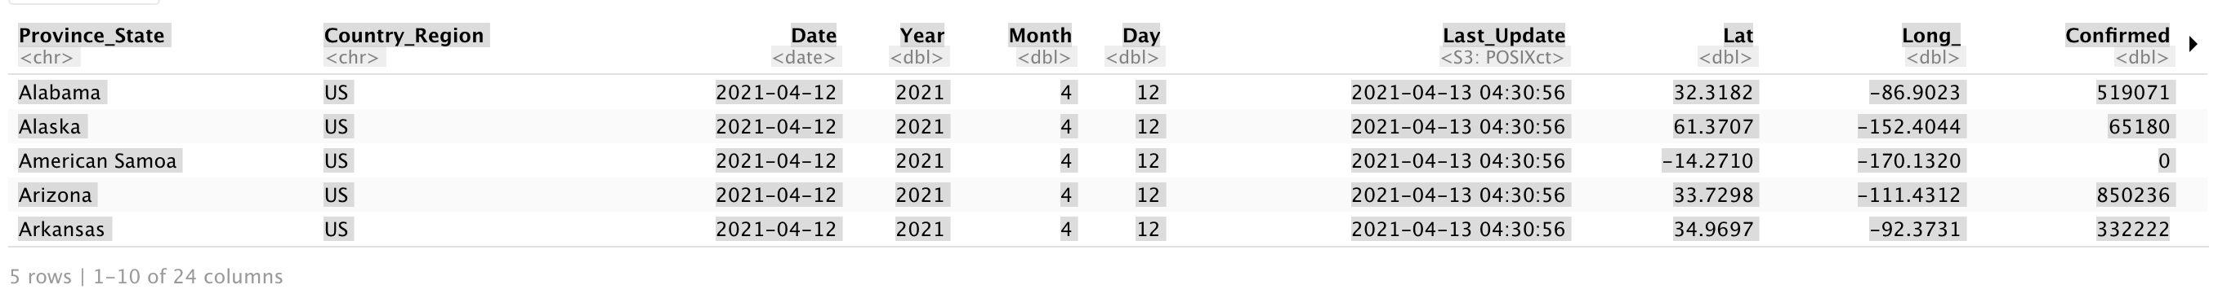
Data Acquisition - JHU CSSE USA Daily Data
US Daily

Slide 4
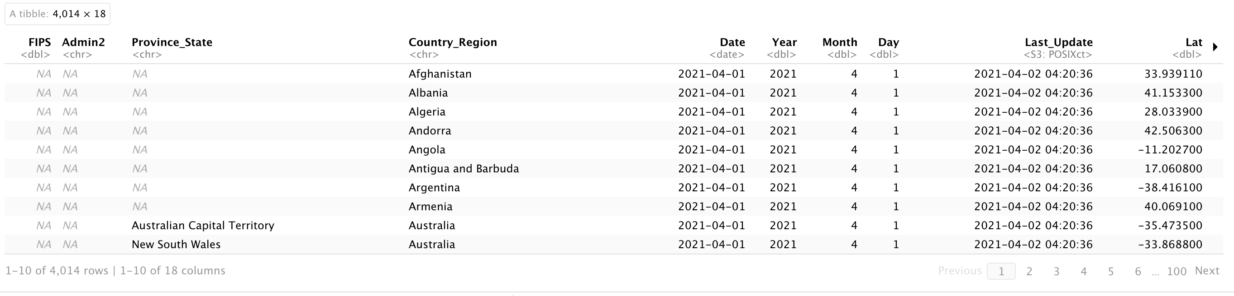
Data Acquisition - JHU CSSE Global timeseries
Global Timeseries

Slide 5
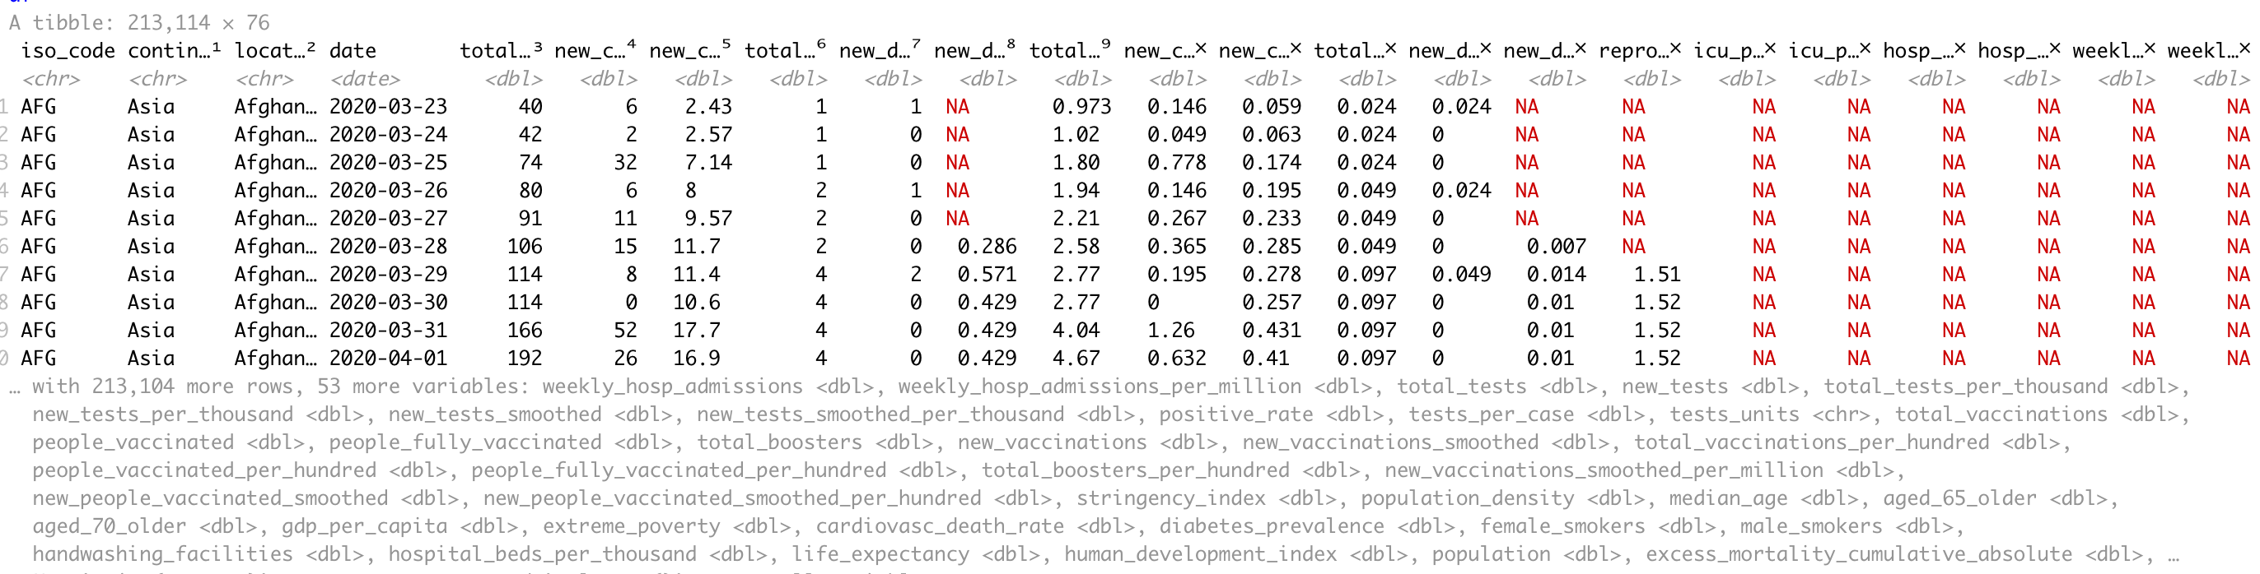
Data Acquisition - Our World In Data
OWID Comprehensive Timeseries

Slide 6
Data Wrangling - Strategy
Common data extraction scripts/functions across datasets
Parallel processing
Table extraction (scraping) from HTML using Selenium/readr
Spark cluster interface

Slide 7
Data Wrangling Milestones
Github API rate limits. Implemented OAuth authentication to access Github via a personal account for higher limits.
OWID dataset did not provide latitude/longitude variables. Downloaded a separate dataset with country lat/long and (left) joined with OWID for plotting on map

Slide 8
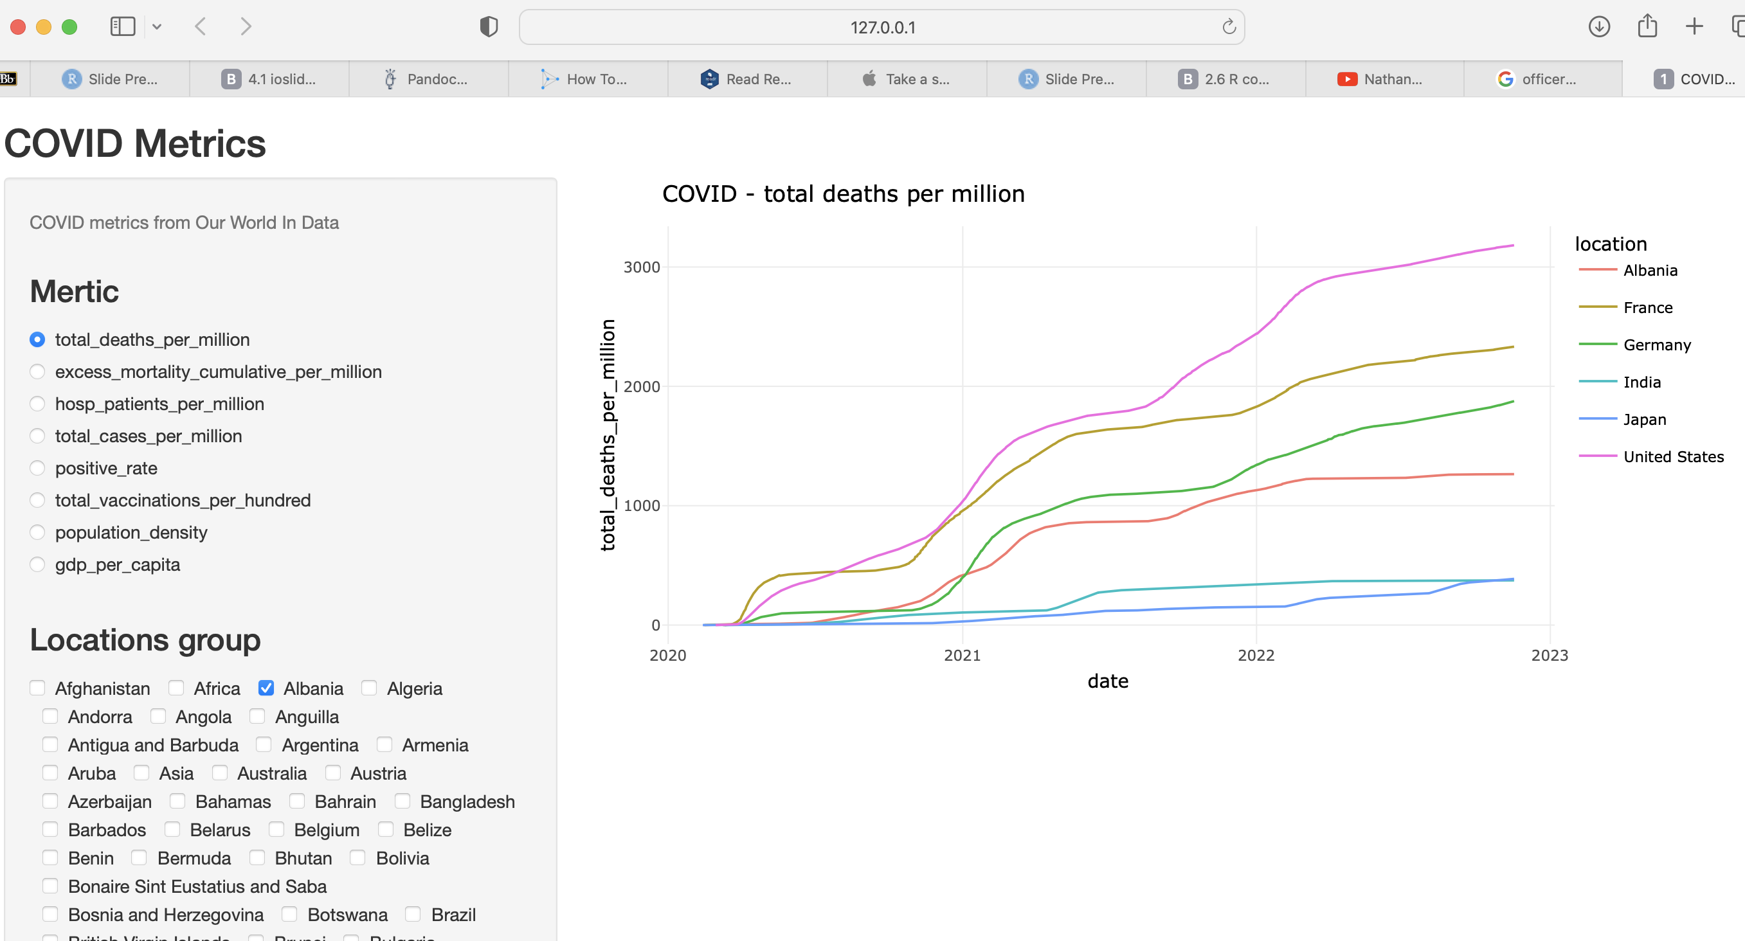
Shiny - interactive data exploration
OWID Comprehensive Timeseries

Slide 9
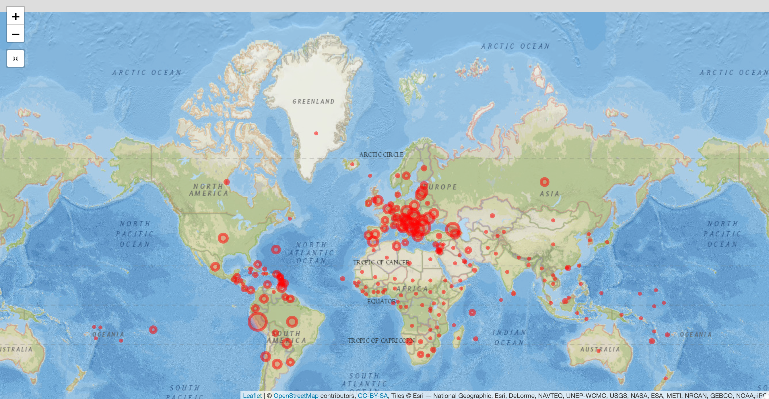
Leaflet - interactive map visualization
OWID Comprehensive Timeseries

Slide 10
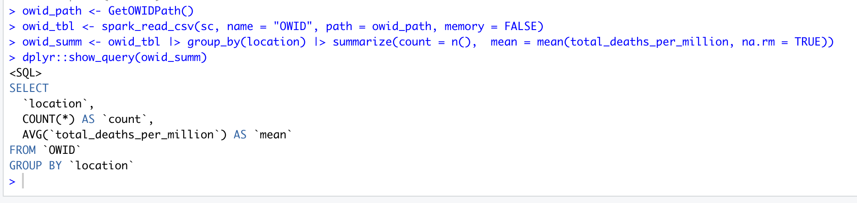
Spark - distributed (Scalable) query, analytics, ML
Spark - Query

Slide 11
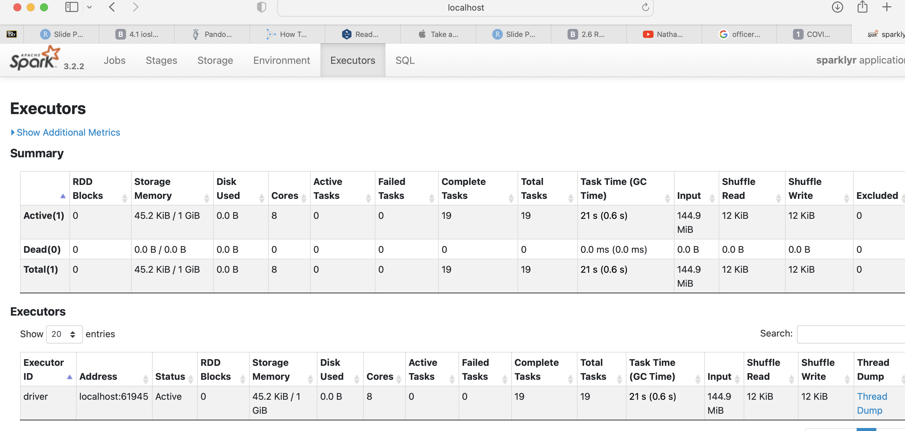
Spark - Executors

Slide 12
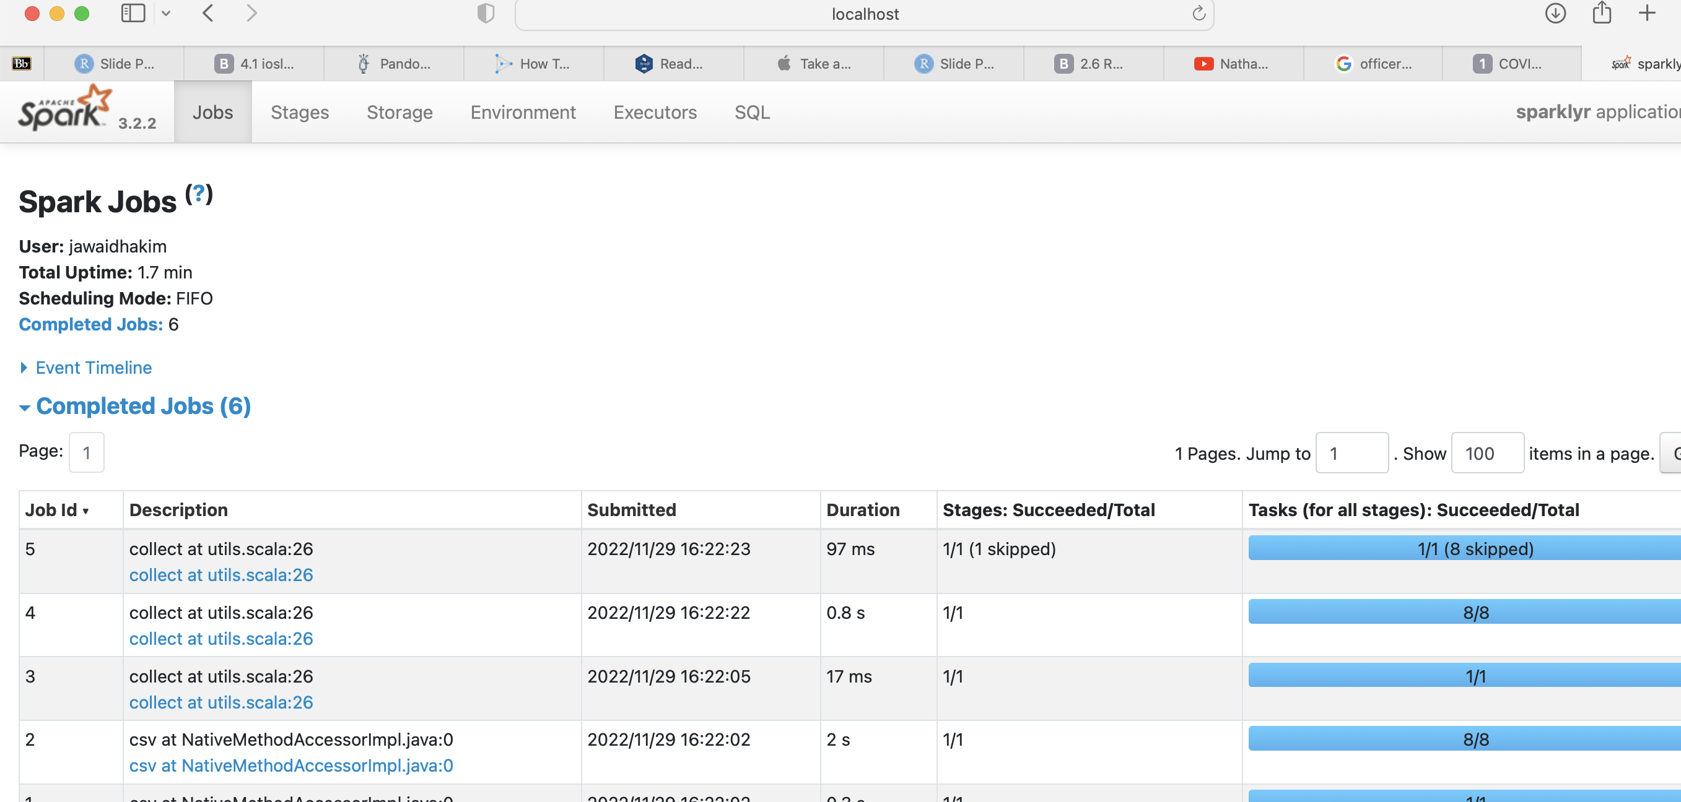
Spark - Completed Jobs

Slide 13
Tech Stack
Rselenium: headless browser for getting around embedded JavaScript
parallel: chosen for efficiently processing remote data files using a local cluster
readr: reading remote/local CSVs
Leaflet: interactive global map
Spark/sparklr: proof-of-concept Spark cluster. Cloud hosted Spark services are fee-based or time-limited - used local cluster
AWS S3: AWS S3 rate-limits made it impractical (20,000 GET Requests; 2,000 PUT, COPY, POST, or LIST Requests each month)

Slide 14
Exploratory Data Analysis
iso_code | continent | location | date | new_deaths | total_deaths_per_million | population_density | excess_mortality_cumulative_per_million
AFG | Asia | Afghanistan | 2020-02-24 | NA | NA | 54.422 | NA
AFG | Asia | Afghanistan | 2020-02-25 | NA | NA | 54.422 | NA
AFG | Asia | Afghanistan | 2020-02-26 | NA | NA | 54.422 | NA
AFG | Asia | Afghanistan | 2020-02-27 | NA | NA | 54.422 | NA
AFG | Asia | Afghanistan | 2020-02-28 | NA | NA | 54.422 | NA
AFG | Asia | Afghanistan | 2020-02-29 | NA | NA | 54.422 | NA
Combining the Covid and Mask Policy datasets
# covid data covid.url <- "https://raw.githubusercontent.com/himalayahall/DATA607-FINALPROJECT/master/data/processed/owid/owid-covid-data.csv" covid <- read_csv(covid.url)
## Rows: 235693 Columns: 67 ## ── Column specification ──────────────────────────────────────────────────────── ## Delimiter: "," ## chr (4): iso_code, continent, location, tests_units ## dbl (62): total_cases, new_cases, new_cases_smoothed, total_deaths, new_dea... ## date (1): date ## ## ℹ Use `spec()` to retrieve the full column specification for this data. ## ℹ Specify the column types or set `show_col_types = FALSE` to quiet this message.
# face covering data fc.url <- "https://raw.githubusercontent.com/himalayahall/DATA607-FINALPROJECT/master/data/source/face-covering-policies-covid.csv" fc <- read.csv(fc.url) # rename columns in fc data to match # convert date to date fc <- fc |> rename(date = Day, iso_code = Code, location = Entity) |> mutate(date = as.Date(date)) # subset the covid data covid.sub1 <- covid |> select(c(1:4,9,14,49,67)) kable(head(covid.sub1))

Slide 15
iso_code | continent | location | date | new_deaths | total_deaths_per_million | population_density | excess_mortality_cumulative_per_million | facial_coverings
AFG | Asia | Afghanistan | 2020-02-24 | NA | NA | 54.422 | NA | 0
AFG | Asia | Afghanistan | 2020-02-25 | NA | NA | 54.422 | NA | 0
AFG | Asia | Afghanistan | 2020-02-26 | NA | NA | 54.422 | NA | 0
AFG | Asia | Afghanistan | 2020-02-27 | NA | NA | 54.422 | NA | 0
AFG | Asia | Afghanistan | 2020-02-28 | NA | NA | 54.422 | NA | 0
AFG | Asia | Afghanistan | 2020-02-29 | NA | NA | 54.422 | NA | 0
Combining the Covid and Mask Policy datasets (cont’d)
# combine covid and face covering datasets co.mask <- covid.sub1 |> left_join(fc, by=c("iso_code","location", "date")) kable(head(co.mask))

Slide 16
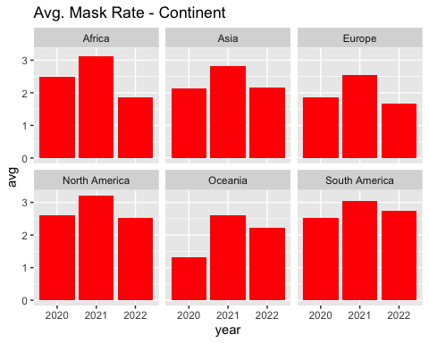
Face Covering Dataset
Source: https://ourworldindata.org/covid-face-coverings
Countries are grouped into five categories:
0 = No policy 1 = Recommended 2 = Required in some specified shared/public spaces outside the home with other people present, or some situations when social distancing not possible 3 = Required in all shared/public spaces outside the home with other people present or all situations when social distancing not possible 4 = Required outside the home at all times regardless of location or presence of other people
Face Covering Dataset (cont’d)
Aggregate - does not account for intra-country dynamics
Mask policy is typically in response to Covid outbreaks
Avg. Mask Rates - Continent
# avg mask rate by continent by year co.mask |> na.omit() |> mutate(year = strftime(date, "%Y")) |> group_by(continent, year) |> summarize(avg_mask = mean(facial_coverings)) |> ggplot(aes(x = year, y = avg_mask, group=1)) + facet_wrap(~continent) + geom_col(fill="red") + labs(y = "avg", title = "Avg. Mask Rate - Continent")
## `summarise()` has grouped output by 'continent'. You can override using the ## `.groups` argument.

Slide 17
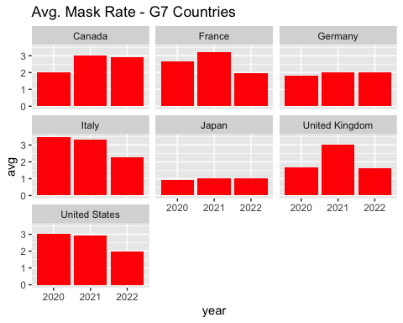
Avg. Mask Rates - G7
# G7 countries countries <- c("Canada","France","Germany","Italy","Japan","United Kingdom","United States") # avg mask rate amongst G7 countries co.mask |> na.omit() |> filter(location %in% countries) |> mutate(year = strftime(date, "%Y")) |> group_by(location, year) |> summarize(avg_mask = mean(facial_coverings)) |> ggplot(aes(x = year, y = avg_mask, group=1)) + facet_wrap(~location) + geom_col(fill="red") + labs (y = "avg", title = "Avg. Mask Rate - G7 Countries")
## `summarise()` has grouped output by 'location'. You can override using the ## `.groups` argument.

Slide 18
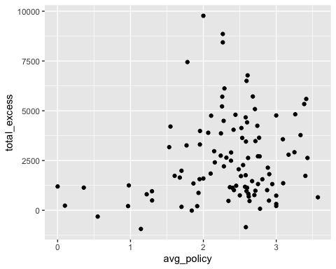
Excess Deaths by Avg. Mask Policy
# total excess deaths by avg mask policy co.em <- co.mask |> filter(!is.na(excess_mortality_cumulative_per_million)) |> select(1:4,7:10) |> rename(excess = excess_mortality_cumulative_per_million, face = facial_coverings) co.em |> na.omit() |> group_by(location) |> summarize(total_excess = max(excess), avg_policy = mean(face)) |> ggplot(aes(x=avg_policy, y=total_excess)) + geom_point()

Slide 19
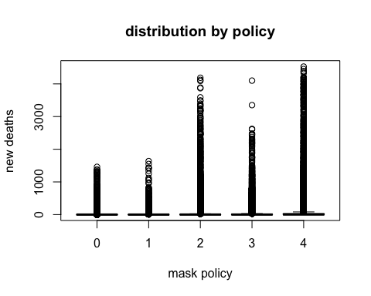
New Deaths by Mask Policy
# subset new deaths co.new <- co.mask |> filter(!is.na(new_deaths)) |> select(3,6,10) |> rename(mask_policy = facial_coverings) # plot new deaths against mask policy boxplot(new_deaths ~ mask_policy, co.new, main="distribution by policy", xlab="mask policy", ylab="new deaths")

Slide 20
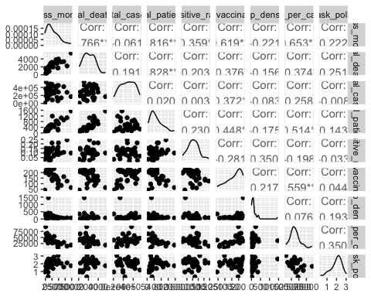
Statistical Analysis
Does average mask policy predict total excess mortality?
The null hypothesis, $H_{0}$ - average mask policy does not predict total excess mortality.
The alternative hypothesis, $H_{A}$ - average mask policy does predict total mortality.
Relationship Between Variables
### Subsetting Covid data by Shiny app cols <- c('location', 'total_deaths_per_million', 'excess_mortality_cumulative_per_million', 'hosp_patients_per_million', 'total_cases_per_million', 'positive_rate', 'total_vaccinations_per_hundred', 'population_density', 'gdp_per_capita') # face mask data subset fc.sub <- fc |> select(c("location","facial_coverings")) covid.sub1 <- covid |> select(all_of(cols)) |> na.omit() |> left_join(fc.sub, by="location") # aggregate the data covid.sub2 <- covid.sub1 |> group_by(location) |> summarize(excess_mortality = max(excess_mortality_cumulative_per_million), total_deaths = max(total_deaths_per_million), total_cases = max(total_cases_per_million), total_patients = max(hosp_patients_per_million), positive_rate = mean(positive_rate), total_vaccinations = max(total_vaccinations_per_hundred), pop_density = mean(population_density), gdp_per_capita = mean(gdp_per_capita), mask_policy = mean(facial_coverings)) ggpairs(covid.sub2[, 2:10])

Slide 21
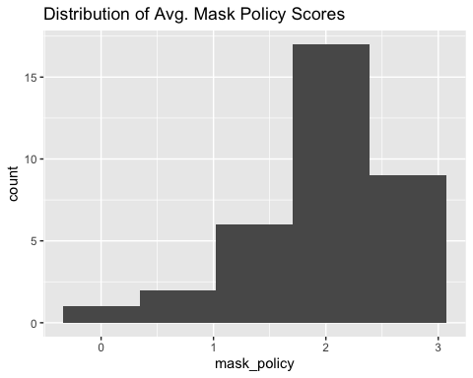
Fitting in a Linear Model
model.1 <- lm(excess_mortality ~ mask_policy + pop_density + gdp_per_capita, covid.sub2) summary(model.1)
## ## Call: ## lm(formula = excess_mortality ~ mask_policy + pop_density + gdp_per_capita, ## data = covid.sub2) ## ## Residuals: ## Min 1Q Median 3Q Max ## -2892.6 -1287.2 -226.7 708.6 5191.2 ## ## Coefficients: ## Estimate Std. Error t value Pr(>|t|) ## (Intercept) 6077.35693 1621.42330 3.748 0.000732 *** ## mask_policy 153.38501 595.59419 0.258 0.798469 ## pop_density -1.75028 1.32304 -1.323 0.195536 ## gdp_per_capita -0.08988 0.02051 -4.381 0.000125 *** ## --- ## Signif. codes: 0 '***' 0.001 '**' 0.01 '*' 0.05 '.' 0.1 ' ' 1 ## ## Residual standard error: 1860 on 31 degrees of freedom ## Multiple R-squared: 0.4573, Adjusted R-squared: 0.4048 ## F-statistic: 8.709 on 3 and 31 DF, p-value: 0.0002444
With an adjusted R-squared of 0.4048, this model only accounts for 40% of the variance in excess mortality. Mask policy also vastly exceeds < 0.05 p-score for significance, so it is not a significant factor.
Improving the Model
# dichotomous variable for mask policy below 2.5 ggplot(covid.sub2, aes(x=mask_policy)) + geom_histogram(bins = sqrt(nrow(covid.sub2))) + labs(title="Distribution of Avg. Mask Policy Scores")

Slide 22
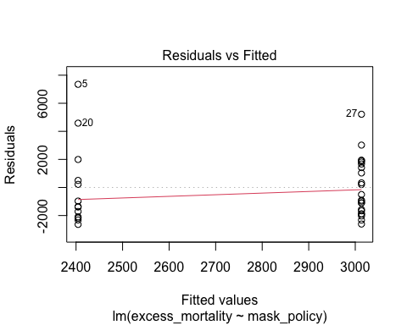
Improving the Model? (cont’d)
mask <- covid.sub2 |> mutate(mask_policy = ifelse(mask_policy > mean(mask_policy), 1, 0)) # linear model utilizing dichotomous variable model.2 <- lm(excess_mortality ~ mask_policy, mask) plot(model.2)

